Slide 1

A Review of Security Standards and Frameworks for IoT-Based Smart
Environments
- SVN Ramakanth
1602-19-733-118

Slide 2
Abstract
The Internet of things (IoT) has become a new trend in our life. This also implies that we need good security standards to safeguard our IoT ecosystems. Assessing the security of IoT-based smart environments such as smart homes and smart cities is becoming essential for implementing the correct control measures and effectively reducing security threats and risks by deploying IoT-based smart technologies. Cumulatively, a total of 80 ISO/IEC security standards, 32 ETSI standards, and 37 different conventional security assessment frameworks, including 7 NIST special publications on security techniques are reviewed in this paper. This paper also discusses open problems and challenges related to IoT-based smart environment security issues.

Slide 3
Content
Introduction
Background Methodology
Review of Existing Standards Open Challenges
Conclusion

Slide 4
Introduction
The Internet of Things (IoT) is relatively a new and emerging technology that is gaining popularity among many stakeholders. Connecting one’s devices and appliances to the Internet. However, exposes them as well as the data sensed, collected, and exchanged by them to a wide range of security threats and risks. Besides, every connected device can become a potential entry or attack point for malicious intruders hence the need for assessing and hardening IoT-based smart environments security
Few examples of IoT systems are:
Lora
ZigBee
MQTT
Z-wave, etc

Slide 5
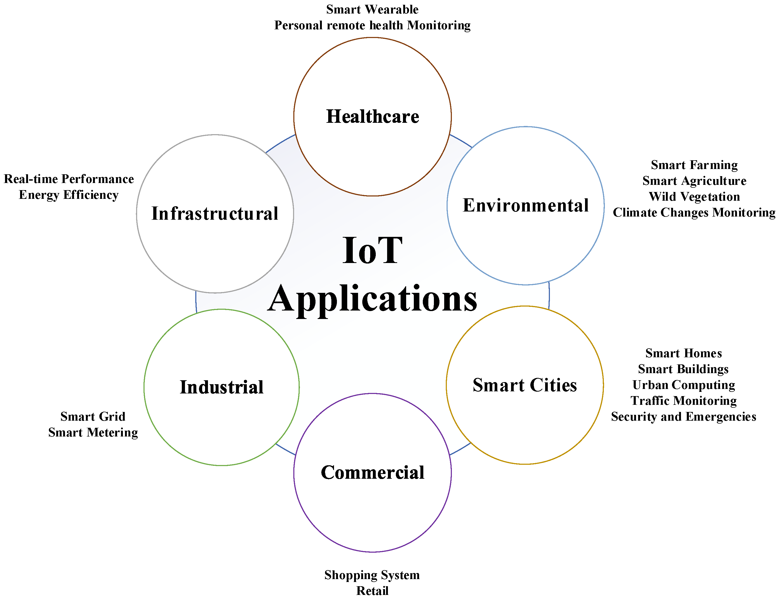
Applications
.

Slide 6
Background
An increased number of IoT devices, ecosystems, and integration has meant that many vulnerable endpoints are being witnessed daily, especially in smart homes, smart cities, global enterprises, and critical infrastructures. IoT-based smart environments are currently a trend that is daily expanding, however, this expansion comes with a lot of complexity, integration, and security issues in the different areas of application. Because of these foregoing, a review of existing conventional security standards and assessment frameworks is positioned to uncover key and perennial security issues in IoT-based smart environments. We deal with security and privacy concerns as a base for the background.

Slide 7
SECURITY CONCERNS
Data and Information Leakage
Eavesdropping
Hacking
IoT Device Security
IoT Device Hijacking and Ransomware
Denial of Service (DoS/DDoS)

Slide 8
Data and Information Leakage
In any IoT smart environment, without proper security mechanisms that protect data and information from malware and other malicious intruders, personal information could easily be leaked resulting in security breaches
Eavesdropping:
With information moving in and around IoT-based smart environments and over to the Internet, malicious attackers can take advantage of unsecured network communications and steal data as it is being transmitted between the connected IoT devices which can lead to other serious security breaches.

Slide 9
Hacking
Most of the data and information collected by IoT devices within smart environments may be stored on internet-accessible systems like the ‘‘Cloud’’.
Many cloud-based IoT devices and systems are known to have security vulnerabilities and can easily be victims of hacking and cyberattacks as data transmission like video data from cameras may not even be encrypted when
sent over the internet.
IoT Device Security
Because of the lack of specialized universal approved IoT security standards or security assessment frameworks, some devices may be manufactured with poor security baselines such as old and unpatched embedded operating systems and software, weak, guessable, or hard-coded passwords, insecure data transfer, and storage, among others. This makes such IoT devices vulnerable to different security threats and attacks.
.

Slide 10
IoT Device Hijacking and Ransomware
As a result of poor security, lack of specialized universal approved IoT security standards, assessment frameworks, and rising numbers in the use of IoT devices, many of these devices may soon become easy targets of ransomware attacks.
.
Denial of Service (DoS/DDoS)
With the advancement in technology, hackers can try to cause DoS/DDoS to exist in hubs in IoT-based smart environment networks or the sensors themselves. However, attackers can also access the network and send bulk messages to IoT devices such as Clear To Send (CTS) and Request To Send (RTS) [11] causing DoS attacks on legitimate IoT devices

Slide 11
PRIVACY CONCERNS
Data Storage and Usage
Tracking and Location Privacy
Context-Aware or Situational Privacy
Sensed, Generated, or Collected Data Privacy

Slide 12
Data Storage and Usage
There is a lack of standardization on how to store and process IoT data from different sources that are mostly unstructured and can lead to a breach of privacy.
This, therefore, calls for the development of universal security and privacy standards, best practices, methods, and tools that can consistently handle IoT data as well as ensure that distributed data is securely accessed and transported with high levels of privacy either to the public or private clouds.
Tracking and Location Privacy
Because of the ease and availability of internet connectivity to IoT devices, tracking users based on location is very common. Once a malicious attacker identifies a user, they can collect data that tracks the user behavior including location history which the attacker can use to stalk a user leading to a breach of privacy
.

Slide 13
Context-Aware or Situational Privacy
As a result of poor security mechanisms implemented in some IoT devices, detecting, spotting, and locating users’ movement, and activities, and gathering data based on actions can possibly lead to a breach of privacy.
.
Sensed, Generated, or Collected Data Privacy
Some manufacturers of IoT devices can design their firmware to collect data sensed or generated by the devices, especially about the usage of services and other data about their customers. The data or information collected in this manner may not fully adhere to the privacy needs of the users, especially during transmission, and may lead to a breach of user privacy

Slide 14
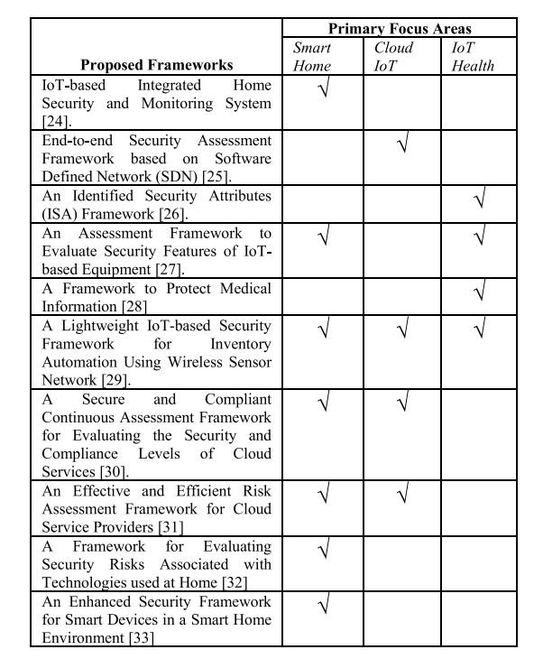
Existing Research work and their primary focus areas

Slide 15
Methodology
The review methodology used in this study comprises three primary phases as follows:
Phase I: Study area identification, the definition of research questions,
sampling and defining the key search strategy or criteria.
Phase II: Applying the search strategy or criteria to known literature, conducting snow bowling search, database search, evaluating the search and defining the selection criteria.
Phase III: Identifying the accepted literature, articles, papers, websites and web documents for review and reviewing based on the selected key study topic.

Slide 16
PHASE I: STUDY AREA IDENTIFICATION
Study area identification in the context of this paper was based on several research questions that also formed the basis of the whole study. Based on this objective the key research questions for this study have been coined as follows:
RQ1: What is the current state of the art of conventional security standards and assessment frameworks with regards to IoT-based smart environments security concerns?
RQ2: Which of the existing conventional security standards and assessment frameworks can be adapted to help address some of the primary security requirements of IoT-based smart environments?
RQ3: What are the open problems and challenges based on the existing exceptions in the security standards and assessment frameworks? Basing our study on the above-mentioned research question, the next phase addresses the key search strategy

Slide 17
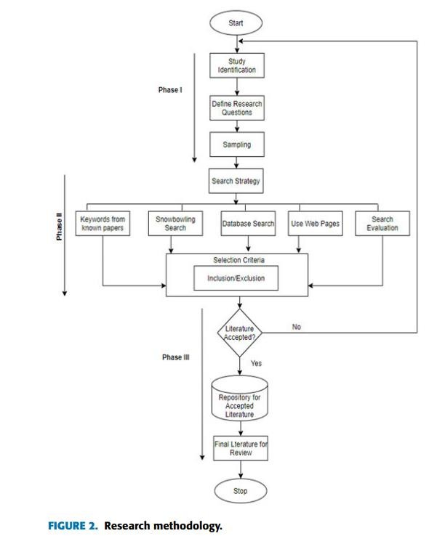
/

Slide 18
PHASE II: SEARCH STRATEGY
The second phase is based on conducting an online search. The scope of this study has been inclined towards security standards and assessment frameworks which also include NIST special publications on security techniques.

Slide 19
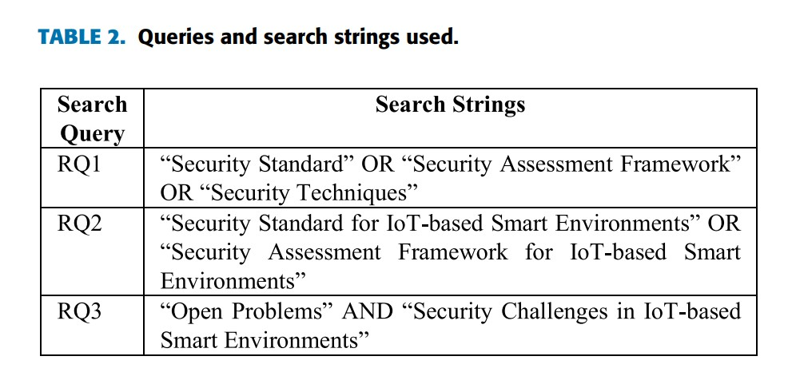
.

Slide 20
PHASE III: IDENTIFYING AND REVIEWING THE LITERATURE
The paper, article, websites, web document, or other special publications are only included in the next phase when all the authors agree that they hold some relevance based on the study objectives
Papers, articles, websites, web documents or any special publications considered not to be relevant by all the authors were deleted or removed from the selection criteria.
All accepted papers, articles, websites, web documents, and special publications were included in a repository ready to be reviewed.

Slide 21
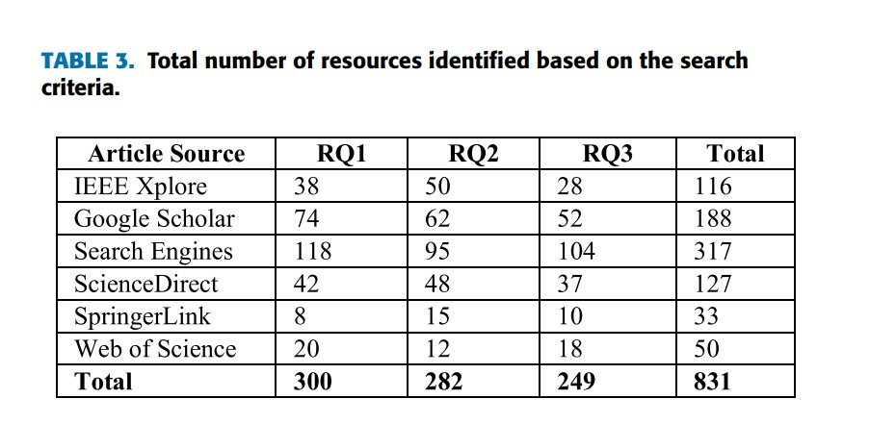
.

Slide 22
REVIEW OF EXISTING SECURITY STANDARDS AND ASSESSMENT FRAMEWORKS
1) NIST CYBERSECURITY FRAMEWORK
The NIST cybersecurity framework was created based on a set of industry standards and best practices to help organizations manage their critical infrastructure cybersecurity risks. It contains analysis through the following five stages:
Identify
Protect
Detect
Response
Recovery

Slide 23
2) NIST RISK MANAGEMENT FRAMEWORK (RMF)
The Risk Management Framework (RMF) provides a comprehensive, flexible, repeatable, and measurable 7-step process that any organization can use to manage information security and privacy risks. The steps are:
Prepare
Categorize
Select
Implement
Assess
Authorize
Monitor

Slide 24
NIST SP 800-53
This special publication on security matters provides security and privacy controls for information systems and organizations to protect organizational operations and assets, individuals, other organizations, and the Nation from a diverse set of security threats and risks, including hostile attacks, human errors, natural disasters, structural failures, foreign intelligence entities, and privacy risks.
NIST SP 800-30
This special publication was developed to guide organizations in conducting information systems risk assessments.

Slide 25
NIST SP 800-12
NIST SP 800-12 was primarily designed for federal and governmental agencies but can also be used by others focusing on control and computer security within an organization.
NIST SP 800-14
The NIST SP 800-14 provides general descriptions of commonly used security principles to help organizations understand cybersecurity policies
NIST SP 800-53R1
NIST SP 800-53R1was designed with a focus on protecting the confidentiality, integrity, and availability of the system and its information

Slide 26
HEALTH INSURANCE PORTABILITY AND ACCOUNTABILITY ACT (HIPAA)
HIPAA was developed to provide guidelines for enabling health plans, health care providers, and health care clearinghouses to implement sufficient controls for securing employee or customer health information and protect sensitive patient health information from being disclosed without the patient’s consent or knowledge. With the growing number of wearable IoT medical devices, HIPAA can be adapted for use in IoT-based smart health systems.
FAMILY EDUCATIONAL RIGHTS AND PRIVACY ACT (FERPA)
FERPA was developed to protect the privacy of student education records and applies to all schools that receive funds under an applicable program of the U.S. Department of Education.

Slide 27
PAYMENT CARD INDUSTRY DATA SECURITY STANDARDS (PCI-DSS)
PCI DSS was designed to help protect the safety of card data and defines a set of requirements intended to ensure that all organizations that process, store, or transmit credit card information maintain a secure environment to reduce credit card fraud. With the increasing usage of near-field communication, PCI-DSS can be enforced in IoT devices such as smartphones that are sometimes used for processing credit card information.
CYBERSECURITY CAPABILITY MATURITY MODEL (C2M2)
Developed by the U.S. Department of Energy (DOE) C2M2 enables organizations to voluntarily measure the maturity levels of their cybersecurity capabilities consistently.

Slide 28
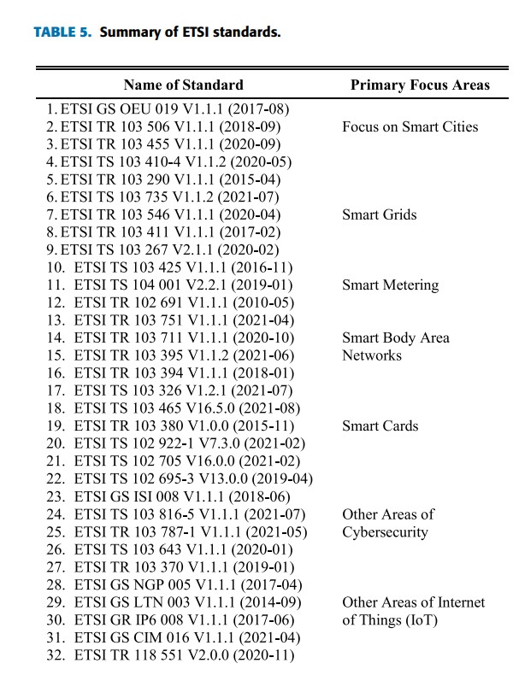
ETSI Standards
.

Slide 29
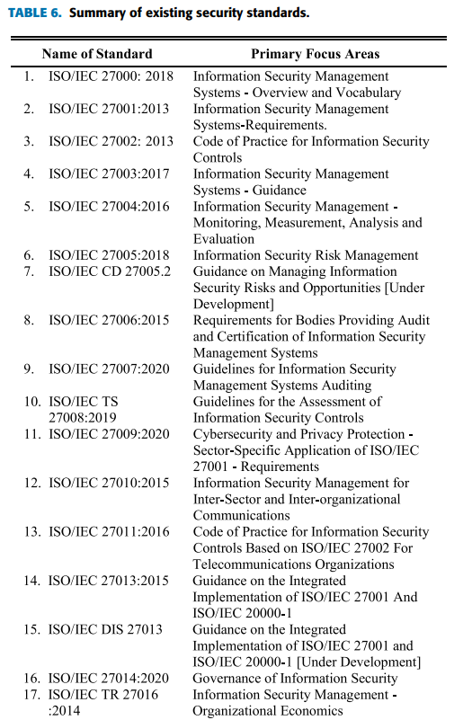
ISO/IEC Standards
.

Slide 30
OPEN PROBLEMS AND CHALLENGES FOR IoT-BASED SMART ENVIRONMENTS
LACK OF STANDARDIZATION
TECHNOLOGY EVOLUTION
SECURITY AND PRIVACY
CONNECTIVITY
LAW ENFORCEMENT AND REGULATIONS
TECHNICAL, LEGAL, AND ETHICAL CHALLENGES

Slide 31
PROPOSED POTENTIAL SOLUTIONS TO THE IDENTIFIED CHALLENGES
Developing security assessment frameworks for IoT-based smart environments
Developing IoT device-specific monitoring tools
Encrypting IoT data moving in and out of IoT-based networks
Testing all IoT hardware before, during, and after deployment
Implementing identity management
Using Strong Credentials
Trust establishment for secure data transmission and object authentication.
Keeping up to date with the latest IoT security threats and breaches

Slide 32
CONCLUSION AND FUTURE WORK
A combination of all these challenges makes the security of IoT-based smart environments much more difficult to develop, implement, enforce, and maintain. The review process revealed the lack of security standards and assessment frameworks that directly addressed the security requirements and needs of IoT-based smart environments. However, more research still needs to be done to improve on the work conducted in this study as well as spark further discussions into the development of new security standards and assessment frameworks for IoT-based smart environments

Slide 33
THANKYOU

